Slide 1
Smart Electric Meter
Developed by
Sundeep D Rahul S Pradeep raj M
Panimalar Engineering college

Slide 2
Components
Arduino Uno Board
Current Sensor (ACS712)
Voltage Sensor
LCD Display (16x2)
Battery (9V)
Plug, Jumper wires.

Slide 3
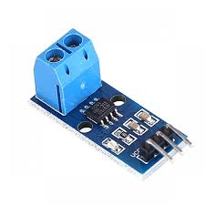
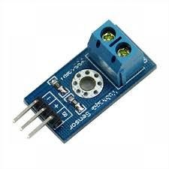
Current and voltage sensor
A current sensor is a device that detects electric current in a wire, and generates a signal proportional to that current. The generated signal could be analog voltage or current or even a digital output. The sensor we used here is named as ACS712
A voltage sensor can measure AC level or/and DC voltage level. The input to the voltage sensor is the voltage itself and the output can be analog voltage signals, switches, audible signals, analog current level, frequency or even frequency modulated outputs.

Slide 4
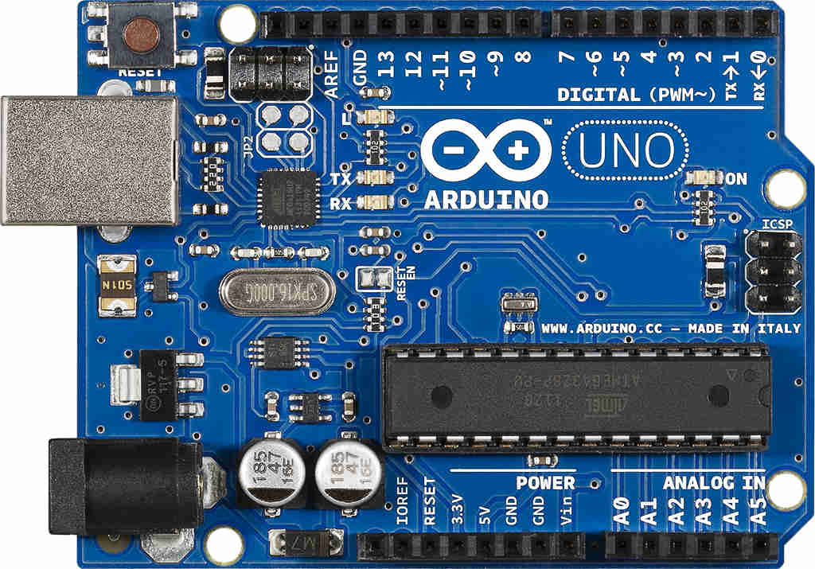
Arduino Uno board
The Arduino Uno board is a microcontroller based on the ATmega328. It has 14 digital input/output pins.
Arduino is an open-source electronics platform based on easy-to-use hardware and software
Arduino senses the environment by receiving inputs from many sensors, and affects its surroundings by controlling lights, motors, and other actuators.

Slide 5
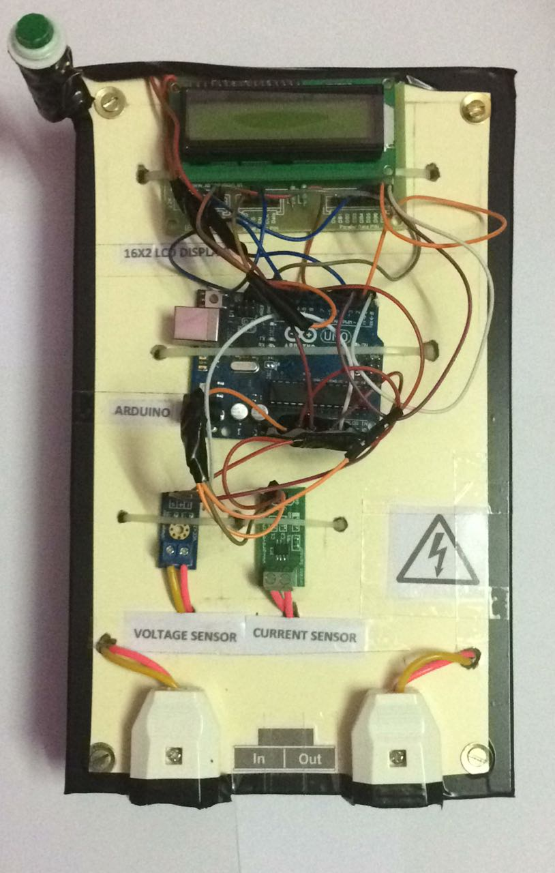
Prototype
A smart meter is an electronic device that records consumption of electric energy in intervals of an hour or less and communicates that information at least daily back to the utility for monitoring and billing.
It is built with two sensors such that the current and voltage can be sensed and the output value is connected to the Arduino Uno.
The Arduino is programmed in a way that calculates the power from the sensor output (P=V*I) and is made to display on the LCD.
With the power units calculated in KWh the amount to be paid is calculated based on the consumption of units with standard tariffs.
The values are updated in Thingspeak so that the readings and cost can be known from anywhere through Thingview application with our unique channel ID.

Slide 6
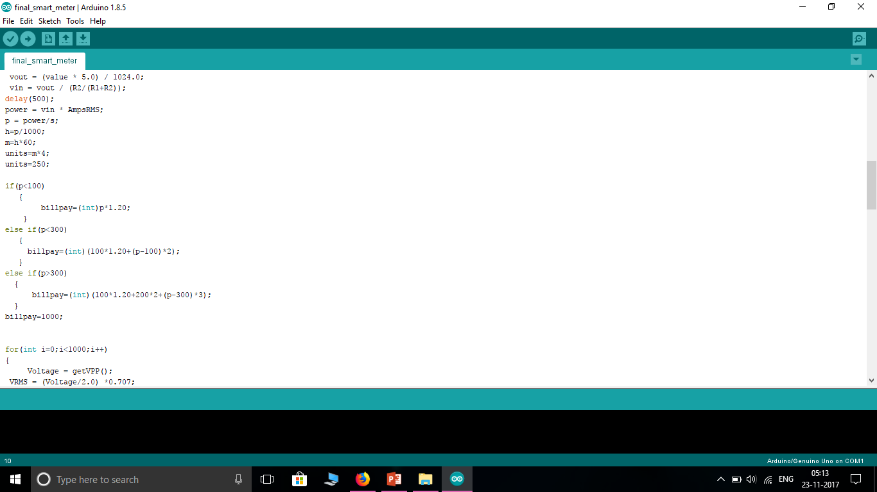
Coding
The code for the smart meter is written in Arduino IDE in such a way that it calculates the power and cost and display it on the LCD.
The bill amount is calculated based units consumption and all the records are updated in the Thingspeak.
A java program is written to get the values from the Arduino with the help of the channel in thingspeak .
The readings are taken from the port where the Arduino is connected.
By mentioning the channel id and the API key in the java code we can obtain the graph of our smart meter with the values of power and cost.

Slide 7
Advantages
Eliminating manual meter reading.
Monitoring the electric system more quickly.
Making it possible to use power resources more efficiently.
Providing real-time data useful for balancing electric loads and reducing power outages (blackouts) .
Enabling dynamic pricing (raising or lowering the cost of electricity based on demand) .

Slide 8
Disadvantages
Smart meters pose these challenges to consumers...
Verifying that the new meter is accurate.
Protecting the privacy of their personal data.
Paying additional fees for the new meter.
CONCLUSION
We will be developing our security to the maximum so that none can act as a third party.
In future the amount to be paid will be sent as a SMS/mail to customers and also a warning indicating more no "of units consumed.

Slide 9


